Slide 1
WEATHER.IO:Weather App
Project Description:
The Weather.io is a web application that provides real-time weather information for a specified location. It utilizes the OpenWeatherMap API to fetch weather data and displays it in a user-friendly interface. Users can search for a location by city name and receive detailed weather information, including temperature, humidity, wind speed, and weather conditions
The Weather.io is a web application that provides real-time weather information for a specified location. It utilizes the OpenWeatherMap API to fetch weather data and displays it in a user-friendly interface. Users can search for a location by city name and receive detailed weather information, including temperature, humidity, wind speed, and weather conditions.

Slide 2
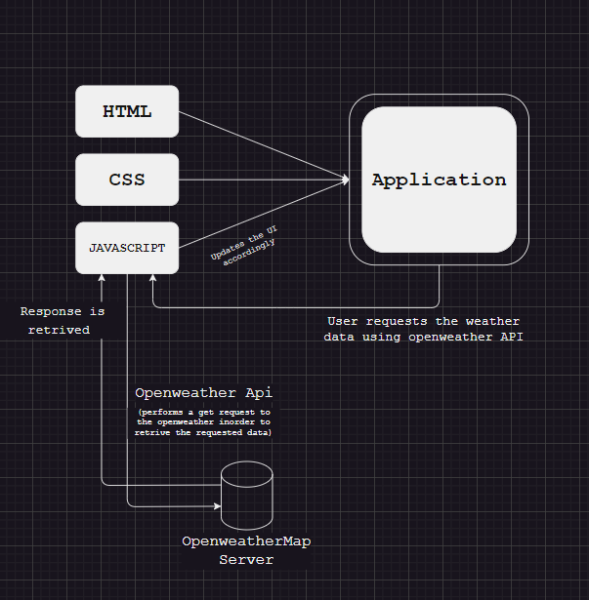
Technical Architecture:
Project Objectives:
By the end of this project, you will:
Create a user interface using HTML and CSS to display weather information.
Utilize JavaScript to interact with the OpenWeatherMap API and fetch weather data.
Dynamically update the UI with the fetched weather data.
Allow users to search for weather information by city name.

Slide 3
Pre-Requisites
Pre-Requisites:
To complete this project, you will need:
A code editor (such as Visual Studio Code, Sublime Text, or Atom)
A web browser
An internet connection
HTML, CSS or Bootstrap, and JavaScript knowledge
OpenWeatherMap API key (sign up at https://openweathermap.org/ to
obtain one)

Slide 4
Project Flow
Project Flow:
To accomplish the objectives, we will complete the following activities:
Set up the project structure
Design and implement the user interface
Connect to the OpenWeatherMap API
Fetch weather data based on user input
Update the UI with the fetched weather data

Slide 5
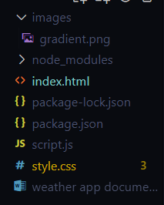
Project Structure
style.css : The CSS file that defines the styles
for the user interface.
script.js : The JavaScript file that handles API
calls and updates the UI.
images/ (optional) : A folder to store any
necessary images for the UI.

Slide 6
Set Up The Project Structure
Create a new project folder for the Weather App.
Inside the project folder, create the following
files/folders:
index.html
style.css
script.js

Slide 7
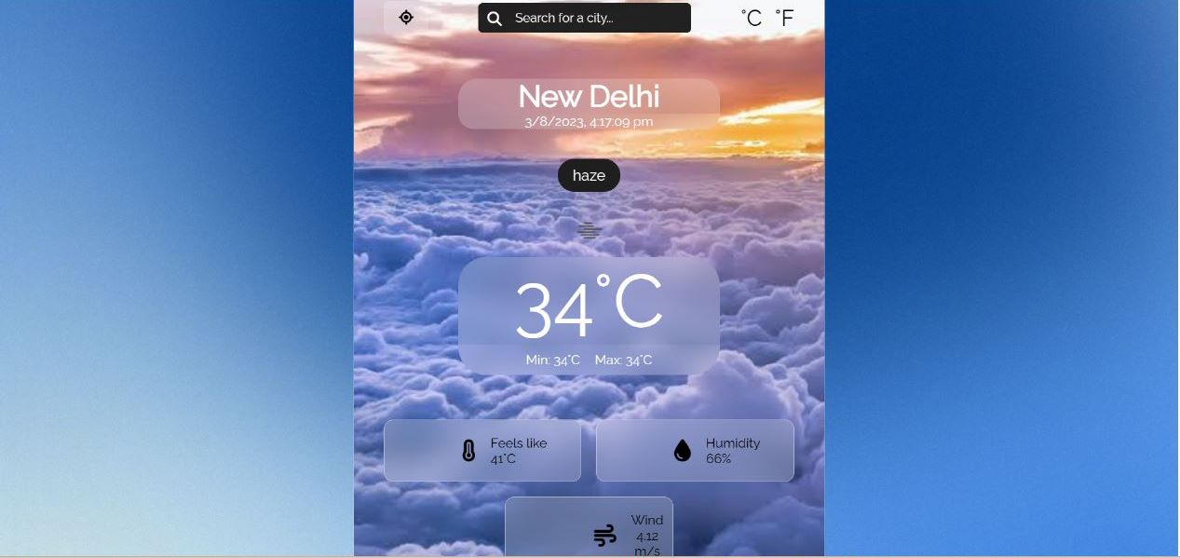
Design and implement the user interface
Open index.html in your code editor.
Set up the basic HTML structure.
Design the layout and structure of the user
interface using HTML elements and CSS classes.
Apply styles to the UI elements using CSS in
style.css.
Link style.css to index.html.

Slide 8
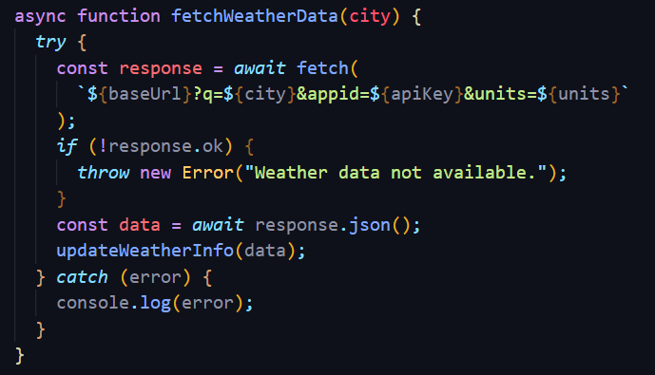
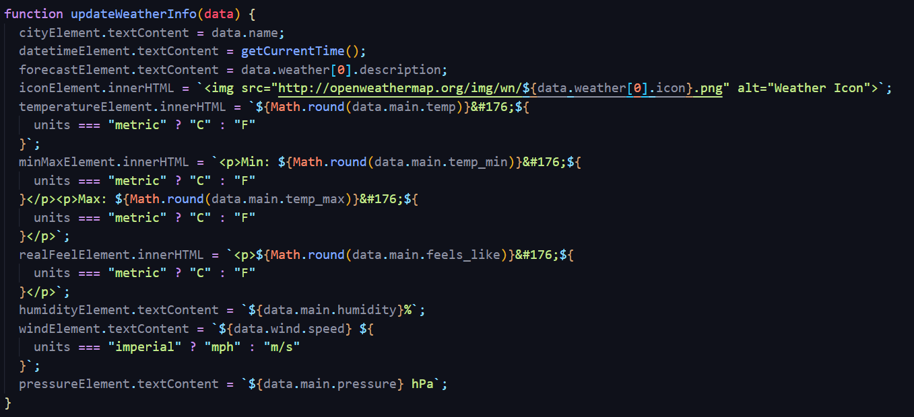
Connect to the OpenWeatherMap API
In script.js, define a constant variable to store your
OpenWeatherMap API key.
Create a function to handle API calls and fetch weather data
from the OpenWeatherMap API.
Use the fetch() function or an AJAX library to make a GET
request to the OpenWeatherMap API, passing the necessary
parameters (e.g. city name).
Handle the API response and extract the relevant weather data.

Slide 9
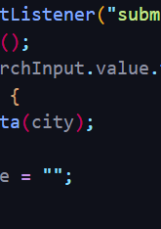
Fetch Weather Data Based On User Input
Add an input field and a button to the UI to allow users
to enter a city name or zip code.
Add an event listener to the button to trigger the
weather data fetch function when clicked.
Retrieve the user input from the input field.
Call the API function, passing the user input as a parameter.

Slide 10
Update The UI With The Fetched Weather Data
Create functions to update the UI with the fetched weather data.
Select the necessary UI elements using JavaScript DOM manipulation methods.Modify the UI elements' content or styles to display the weather information dynamically.
As you can see there is button In between search and degrees,which is a button when clicked tells you the weather of your current location this uses geolocation property in js.

Slide 11
Conclusion:
The Weather App is a web application that provides real-time weather information to users. By integrating the OpenWeatherMap API and implementing an intuitive user interface, users can easily retrieve weather data for a specific location. The project's modular structure allows for easy maintenance and further enhancements, such as adding additional features or optimizing the UI.

